Slide 1
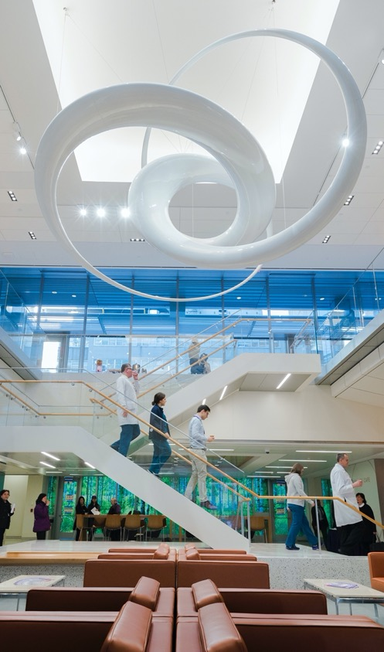
Rigor and Reproducibility:
Scientific Premise I
Fred LaPolla MLS

Slide 2
Review

Slide 3


Name some ways the power of a study can be increased
ⓘ
Click Present with Slido or install our Chrome extension to activate this poll while presenting.
Notes:
📣 This is Slido interaction slide, please don't delete it. ✅ Click on 'Present with Slido' and the poll will launch automatically when you get to this slide.

Slide 4

What role does randomization play with regards to reproducibility?
ⓘ
Click Present with Slido or install our Chrome extension to activate this poll while presenting.
Notes:
📣 This is Slido interaction slide, please don't delete it. ✅ Click on 'Present with Slido' and the poll will launch automatically when you get to this slide.

Slide 5
Which of the following is true of p values?
ⓘ
Click Present with Slido or install our Chrome extension to activate this poll while presenting.
Notes:
📣 This is Slido interaction slide, please don't delete it. ✅ Click on 'Present with Slido' and the poll will launch automatically when you get to this slide.

Slide 6
Agenda
PubMed searching
Other databases
Incorporating AI search

Slide 7
Outcomes
Students will be able to explain the use of boolean operators (AND, OR, NOT) in searching
Students will be able to explain strengths and weaknesses of AI in search
Students will be able to identify additional literature sources

Slide 8
Scientific Premise

Slide 9
NIH Guidelines
The NIH requires grant applicants to describe the strengths and weaknesses of prior research
This includes planning to address the weaknesses in prior research

Slide 10
Animal Research
Similar issue, the Institutional Animal Use and Care Committee (IACUC) requires evidence of a thorough literature search to justify animal use

Slide 11

Where do you currently search for literature
ⓘ
Click Present with Slido or install our Chrome extension to activate this poll while presenting.
Notes:
📣 This is Slido interaction slide, please don't delete it. ✅ Click on 'Present with Slido' and the poll will launch automatically when you get to this slide.

Slide 12
What are the challenges you face in searching for literature (if any)?
ⓘ
Click Present with Slido or install our Chrome extension to activate this poll while presenting.
Notes:
📣 This is Slido interaction slide, please don't delete it. ✅ Click on 'Present with Slido' and the poll will launch automatically when you get to this slide.

Slide 13
Search strategies
Let’s say you are interested in genomic markers of lung cancer and working in mouse models

Slide 14
Search strategies: PICO/PECO
Comparison
Population/Person/Problem
Outcome
Intervention/Exposure

Slide 15
Search strategies: PICO/PECO
Comparison: NA
Population: Mice
Outcome: Lung Cancer
Exposure: Genomic Markers

Slide 16
Create a PECO/PICO to address: Are changes in the oral microbiome related to increased risk of mouth cancer in smokers? Add your term with a P, I/E, C or O.
ⓘ
Click Present with Slido or install our Chrome extension to activate this poll while presenting.
Notes:
📣 This is Slido interaction slide, please don't delete it. ✅ Click on 'Present with Slido' and the poll will launch automatically when you get to this slide.

Slide 17
Jump to PubMed to search these terms

Slide 18
PubMed Techniques

Slide 19
Expanding Your Search
Find synonyms (words with the same or similar meaning) for each element of the P I/E C O
A spreadsheet can help

Slide 20
Expanding Your Search
Population | Exposure | Comparison | Outcome
Mice | Genomic | NA | Lung Cancer
Mouse | Genome |  | Pulmonary Neoplasms
Mus | Gene |  | Lung Neoplasms
Murine | Genetic |  | Pulmonary Cancer

Slide 21
Expanding Your Search: OR down each column
Population | Exposure | Comparison | Outcome
Mice | Genomic | NA | Lung Cancer
Mouse | Genome |  | Pulmonary Neoplasms
Mus | Gene |  | Lung Neoplasms
Murine | Genetic |  | Pulmonary Cancer
OR
OR
OR
OR
OR
OR
OR
OR
OR
OR
OR

Slide 22
Where to find terms
Abstracts
Knowledge of field
ChatGPT/LLM systems
MeSH

Slide 23
Other NCBI Resources
Gene: Searchable database of genes including name, localization, products, attributes, markers, phenotypes, interactions, citations
MedGen: Clinically oriented database of genes, conditions and links to literatures
ClinVar: A searchable database of conditions, genetic variations and genes. Records link to citations when available

Slide 24
List keywords for the search: Are changes in the oral microbiome related to increased risk of mouth cancer in smokers? Add your term with a P, I/E, C or O.
ⓘ
Click Present with Slido or install our Chrome extension to activate this poll while presenting.
Notes:
📣 This is Slido interaction slide, please don't delete it. ✅ Click on 'Present with Slido' and the poll will launch automatically when you get to this slide.

Slide 25
List MeSH terms for: Are changes in the oral microbiome related to increased risk of mouth cancer in smokers? Add your term with a P, I/E, C or O.
ⓘ
Click Present with Slido or install our Chrome extension to activate this poll while presenting.
Notes:
📣 This is Slido interaction slide, please don't delete it. ✅ Click on 'Present with Slido' and the poll will launch automatically when you get to this slide.

Slide 26
Note about Quotation Marks
Keywords any terms in the title, abstract or other bibliometric information
Can be author submitted
MeSH are specific tags provided by subject experts at the NLM
We can actually focus in by adding a MeSH tag and then [Majr], e.g. “Lung neoplasms”[Majr]

Slide 27
Note on Quotation Marks
In PubMed, quotation marks do not work the same as in Google:
Quotes turn off term mapping and try to connect to one of a set number of phrases in a “term list.” In general try without quotes first.

Slide 28
Constraining Your Search: AND Across
Population | Exposure | Comparison | Outcome
Mice | Genomic | NA | Lung Cancer
Mouse | Genome |  | Pulmonary Neoplasms
Mus | Gene |  | Lung Neoplasms
Murine | Genetic |  | Pulmonary Cancer
OR
OR
OR
OR
OR
OR
OR
OR
OR
OR
OR
AND
AND

Slide 29
Constraining Your Search: AND Across
(Mouse OR Mice OR Mus OR Murine OR “Mice”[Mesh])
AND
(Genomic OR Genome OR Gene OR Genetic OR “genome”[Mesh] )
AND
(Lung Cancer OR “Lung Neoplasms”[MeSH] OR Pulmonary Neoplasm OR Pulmonary Cancer)

Slide 30


AND vs. OR
AND
OR
OR
OR

Slide 31
Other Things to Consider
Consider the context of your terms: for example the patient/population group
Avoid arbitrary date filters. Whenever filtering on a date, consider why that date is theoretically important.
Avoid wildcards * in PubMed, they tend to work poorly

Slide 32
Useful tags
[tiab] = Title and Abstract. This will search for terms only in these locations, ignoring journal titles or other information.
[au] = Author
[jour] = Journal
[ot] = Keywords provided by the author (stands for other terms)

Slide 33
LLMs and Search

Slide 34
LLMs and Search
So far, mostly returns hallucinations (invented results)
BingGPT can search websites and be directed to PubMed but in my experience does not work

Slide 35
LLMs and Search
Useful for harvesting search terms:
Just ask for terms on a topic
Add an abstract that is useful and harvest search terms: add them to your PICO table

Slide 36
LLMs and Search
Currently AI systems cannot log in to Langone’s databases and search for full text
For anything behind a firewall, you need to login and retrieve

Slide 37
Elicit and Search
beta.elicit.org
Designed Explicitly for literature searching and summary
Currently relies on Semantic Scholar and primarily open access journals

Slide 38
Scite.ai and Search
https://scite.ai/
Designed Explicitly for literature searching and summary
Unclear where it is searching
Strong citation tool

Slide 39
Perplexity.ai and Search
A better resource, and you can specify the source.
Good for finding general background information, might not be as ideal for very deep dives like those you need for your thesis.

Slide 40
A Search that worked alright for me
PubMed search for articles on mouse model head and neck squamous cell cancers and genomic markers. Provide titles, authors, dates, abstracts and links to articles on PubMed in a table. If you do not know, write "IDK." After the table, provide a PubMed search string that would find similar articles, including the ones you found.

Slide 41
Try it on your own. What was your query and how did you feel about the results?
ⓘ
Click Present with Slido or install our Chrome extension to activate this poll while presenting.
Notes:
📣 This is Slido interaction slide, please don't delete it. ✅ Click on 'Present with Slido' and the poll will launch automatically when you get to this slide.

Slide 42
AI Literature Search Tools
I have only minimally explored but some are:
Perplexity.ai
https://elicit.org/
https://researchrabbitapp.com/home
https://www.semanticscholar.org/
https://scite.ai/ (fee based)

Slide 43
Additional Databases

Slide 44
Google Scholar
Synonyms not necessary and will cut off
Fast and familiar
Not as reproducible for searching

Slide 45
Google Scholar
Google | PubMed | Purpose
- | NOT | Exclude a term
“” | “” | Google searches for a specific phrase, PubMed tries to match a phrase to a list of terms
author: f lapolla | lapolla f[au] | Author search

Slide 46
Web of Science
https://hslguides.med.nyu.edu/WebOfScience
Good for tracking citations
Can work with AND, OR and NOT

Slide 47
Embase
https://hslguides.med.nyu.edu/EMBASE
Large medical database with international coverage
Stronger conference and pharmaceutical coverage than PubMed

Slide 48
Incidence and Prevalence
https://hslguides.med.nyu.edu/IPD
https://hslguides.med.nyu.edu/IPD
Large database of incidence and prevalence data
Incidence = how common new diagnoses are
Prevalence = how common a given diagnosis is in the population

Slide 49
Review

Slide 50
For terms all relating to Patient/Population (synonyms for population) what word do we combine them with? For example if we want every term for mouse to show up what do we use (and, or not)?
ⓘ
Click Present with Slido or install our Chrome extension to activate this poll while presenting.
Notes:
📣 This is Slido interaction slide, please don't delete it. ✅ Click on 'Present with Slido' and the poll will launch automatically when you get to this slide.

Slide 51
Why is it not very helpful currently to ask ChatGPT or Bard for literature?
ⓘ
Click Present with Slido or install our Chrome extension to activate this poll while presenting.
Notes:
📣 This is Slido interaction slide, please don't delete it. ✅ Click on 'Present with Slido' and the poll will launch automatically when you get to this slide.

Slide 52
What does P I/E C O stand for?
ⓘ
Click Present with Slido or install our Chrome extension to activate this poll while presenting.
Notes:
📣 This is Slido interaction slide, please don't delete it. ✅ Click on 'Present with Slido' and the poll will launch automatically when you get to this slide.

Slide 53

Homework
You are interested in the role of BRCA1 in cancer among smokers. Build a thorough search to avoid missing relevant abstracts in PubMed. This should include the use of synonyms, boolean operators like AND, OR and NOT; parentheses to group like terms. Provide the string you searched in PubMed and the number of results. Your search and results must work (ie not merely be an AI hallucination) to get credit.
Also answer the following:
What are places you could look for useful terms?
If you were getting too many results, what are some ways you could narrow down the search?

Slide 54
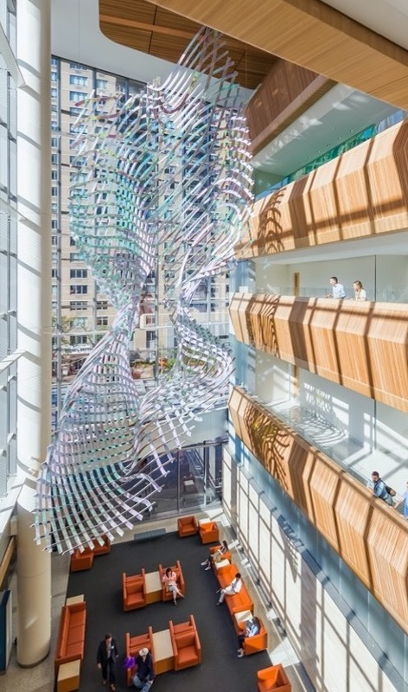
Have a great week!
fred.lapolla@nyulangone.org

Slide 55
References
1. DeSimone D. Plovnick, C. Subject Guides: AI in Healthcare: Educational Resources [Internet]. [cited 2023 Aug 21]. Available from: https://hslguides.med.nyu.edu/aihsl/education

